Slide 1
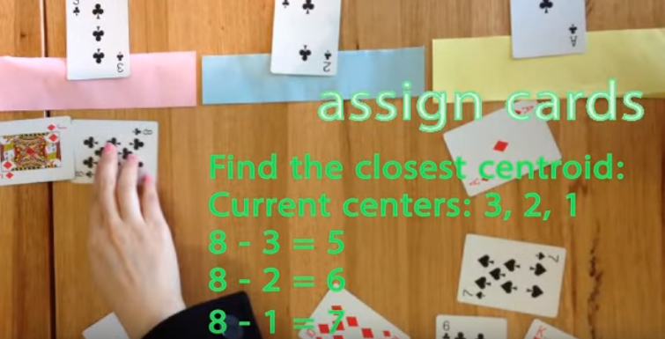
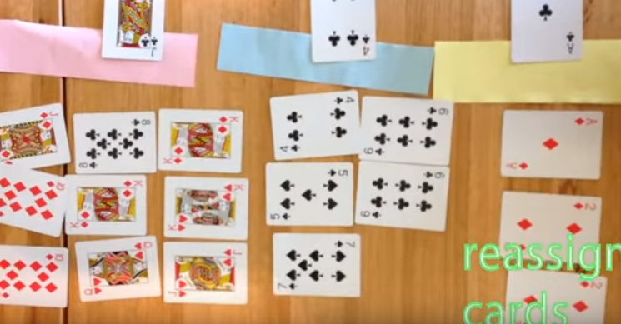
https://www.youtube.com/watch?v=zHbxbb2ye3E

